Slide 1
PYTHON
WEEK 10 TOPICS:
WORKING WITH DATES
WORKING WITH WEB DATA

Slide 2
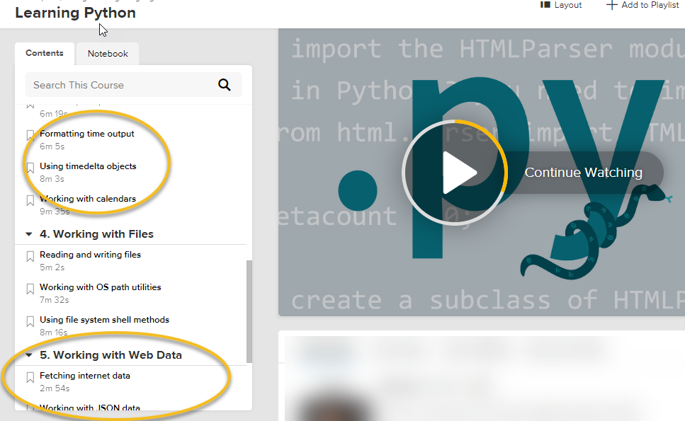
Notes:
https://www.lynda.com/Python-tutorials/Learning-Python/661773-2.html

